Slide 1

Interacting with the World
SCAN QR
Through the Internet
Group 20
Phạm Hoài Nam: 21000394
Phạm Hồng Quân :21001575
Phan Thị Thu Trang: 21001593

Slide 2
Table of Contents
01
02
03
04
Overview of Computer Network
The basic knowledge of computer networks
The Internet
Definitions, Internet protocols and network layers
World Wide Web
Defintions, Features, and its Applications

Slide 3
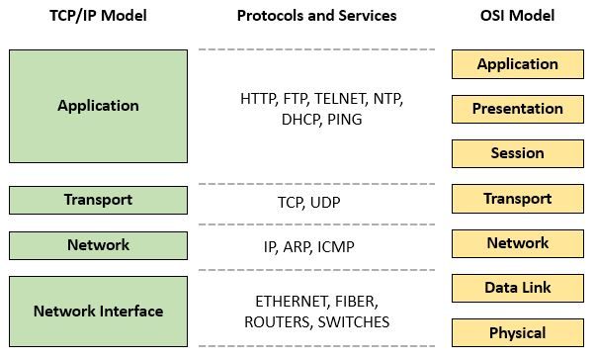
TCP/IP Model
World Wide Web
The Internet
Computer Networks

Slide 4
01
Computer Network

Slide 5
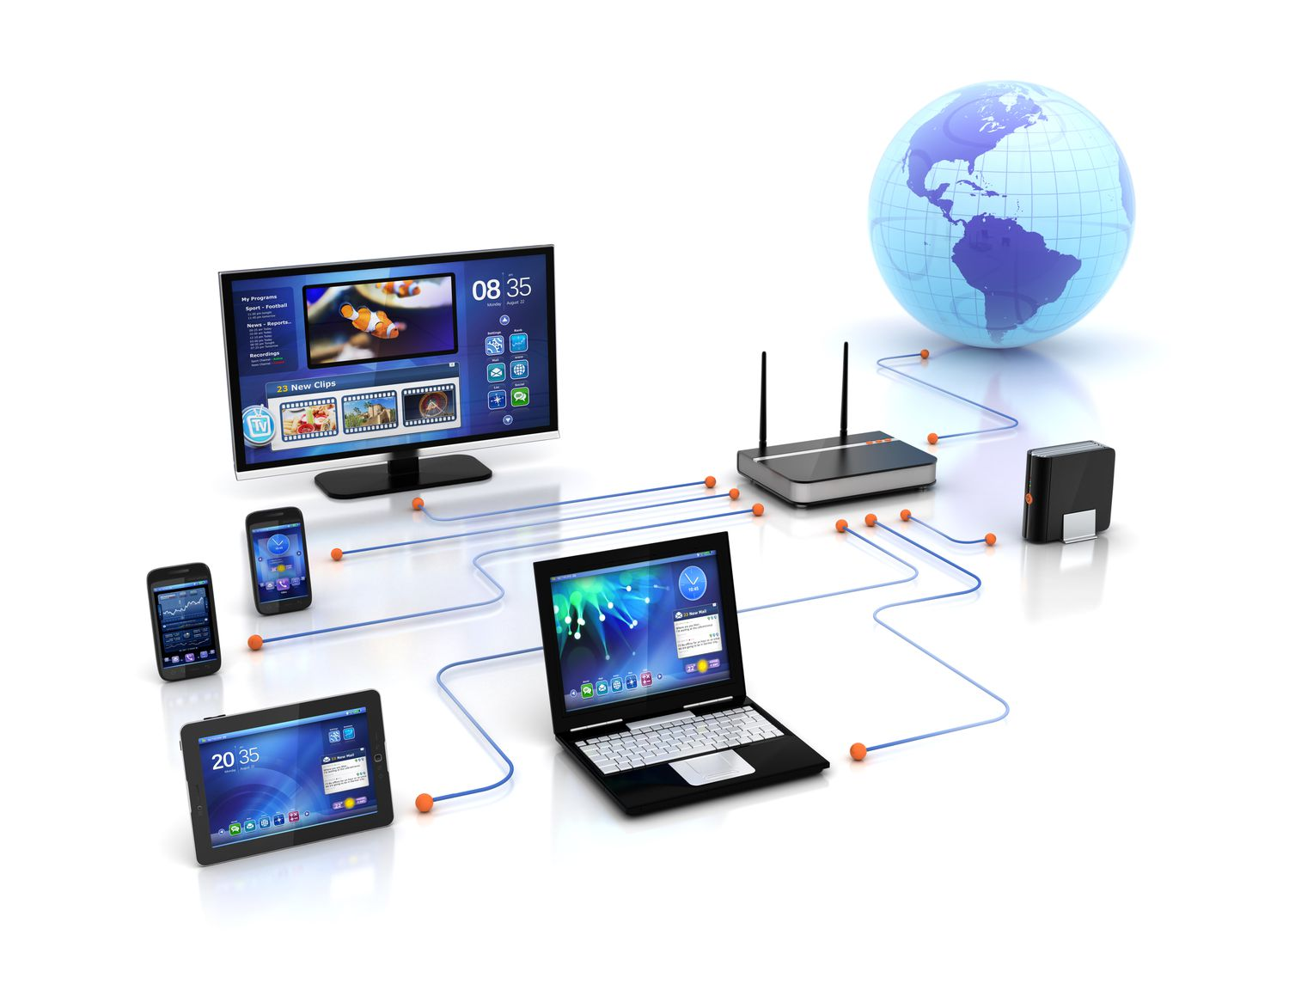
Computer Networks
A computer network is a group of interconnected computers and devices that are able to communicate with each other and share resources such as data, files, printers, and applications

Slide 6
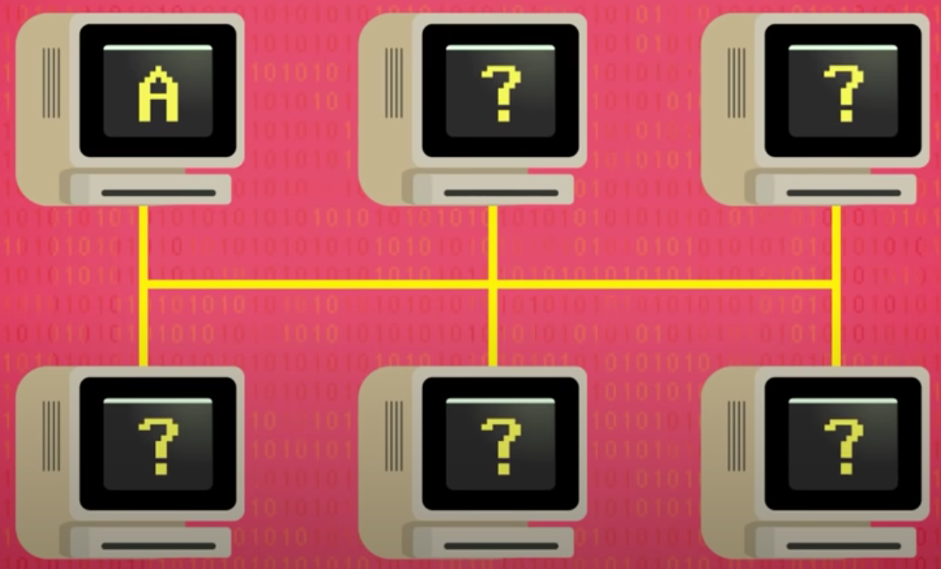
Features of Computer Networks
Ethernet
Ethernet is a standard for connecting computers and other devices in a local area network (LAN).
It was first developed by Xerox Corporation in the 1970s.
It is a series of computer connected to the Ethernet cable, it writes data as an electrical signal onto the cable to transmit data.
PROBLEM
When transmit data to another computer, it doesn’t know if data is intended for them or another computer

Slide 7
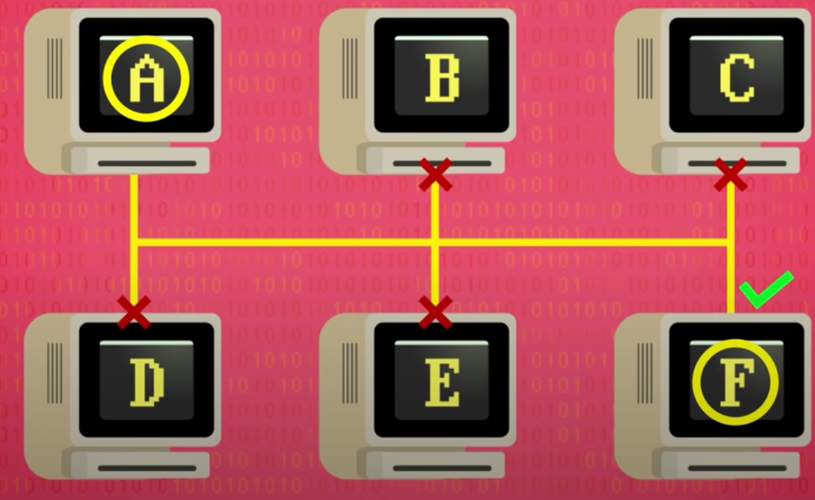
Features of Computer Networks
MAC Address
MAC addresses are unique identifiers assigned to network devices at the factory
They are used to identify devices on a network and to ensure that data is sent to the correct device
PROBLEM
Collision among different computer when they attempt to write data at the same time

Slide 8
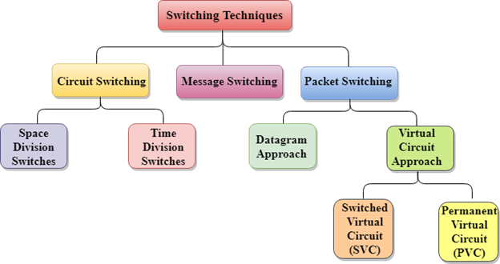
Features of Computer Networks
Switching Techniques
Circuit Switching
Message Switching
Packet Switching
Network switches are devices used to connect multiple devices on a network.
They allow for more efficient data transmission and help to reduce network congestion.
Packet switching is generally considered to be the most efficient and flexible method of communication

Slide 9
02
The Internet

Slide 10
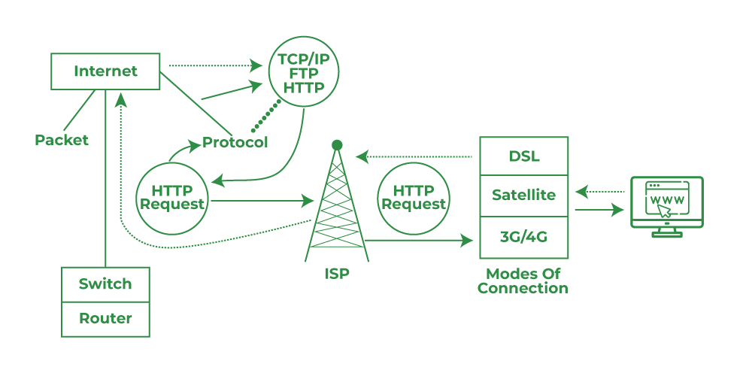
- The Internet is a large, distributed network including many other small networks. It’s arranged as an ever-enlarging web of interconnected devices.
- The Internet works through a system of routers and switches that help to direct data packets to their destination.
What is the Internet?

Slide 11
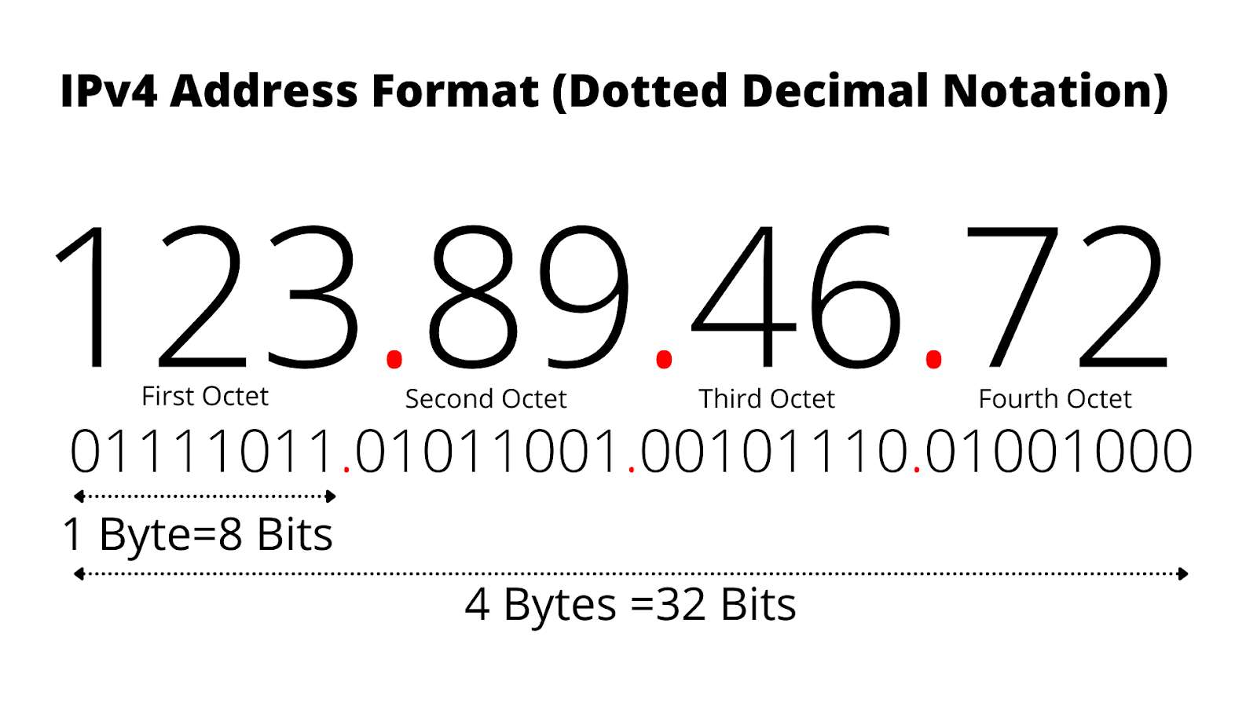
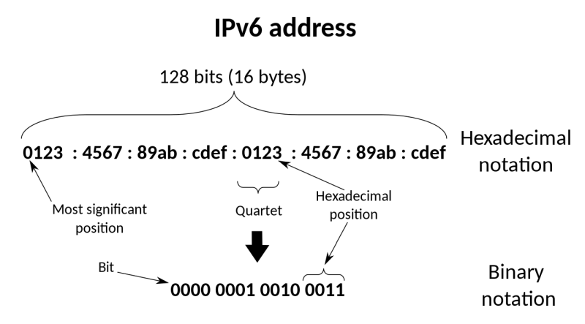
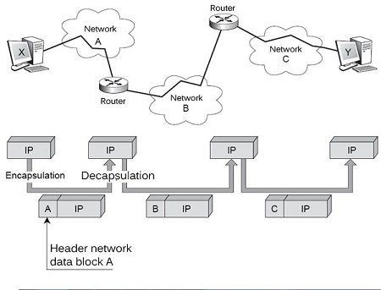
Internet Protocol (IP)
Internet Protocol is a term to interpret what procedures the Internet use to send data from a computer to others.
ISSUE
IP(IPv4) is a very low level protocol – there isn’t much more than a destination address

Slide 12

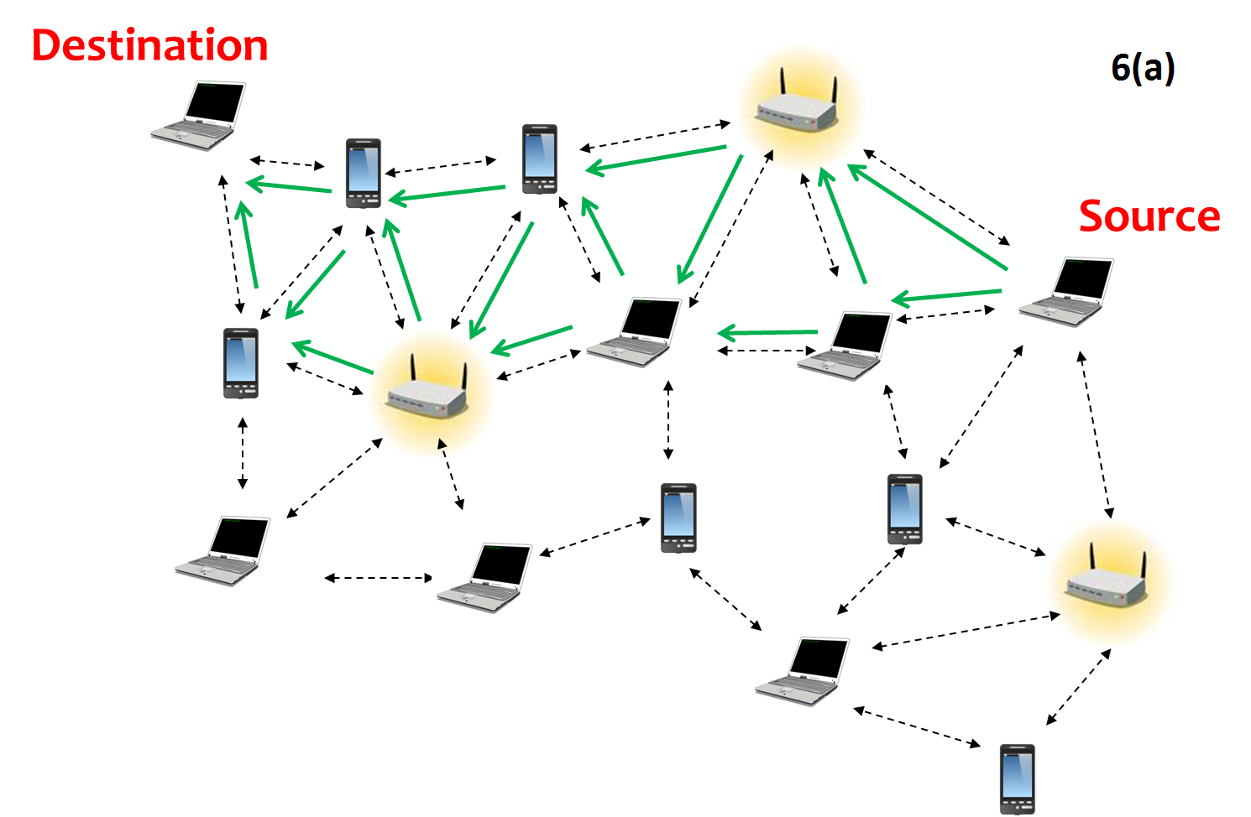
- The Transport Layer is responsible for providing end-to-end communication between devices on a network. It is responsible for the segmentation, reassembly, and reliable delivery of data between the source and destination devices.
- The Transport Layer adds a header to the data The header contains information such as source and destination port numbers, sequence and acknowledgment numbers, and control flags, which are used by the Transport Layer to ensure the proper delivery of data to the destination device.
How to transport data in the Internet?

Slide 13
UPD
IP Header | Port = …, Checksum= 60 | 10 | 10 | 10 | 10 | 10 | 10
UDP Header
Data
PROBLEM
UDP is often referred to as an unreliable protocol because it doesn’n have any flow control or error recovery mechanism

Slide 14


TCP
ACK protocol
Sender
Received
Receiver

Slide 15
Transport Layer
UDP
TCP
- UDP is much simpler and faster
- TCP has built-in systems to check for errors and to guarantee data will be delivered in the order it was sent
- UPD is often used for real-time applications such as video calls, streaming, online games, …
- Perfect protocol for transferring information like images, data files, and web pages.

Slide 16
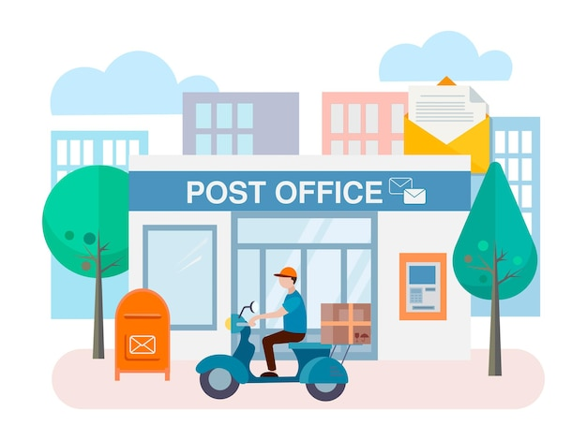

Slide 17
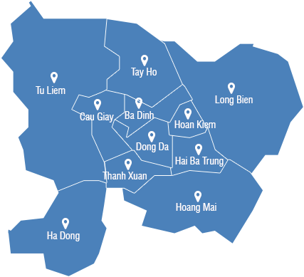


1
2
3
4

Slide 18
03
World Wide Web

Slide 19
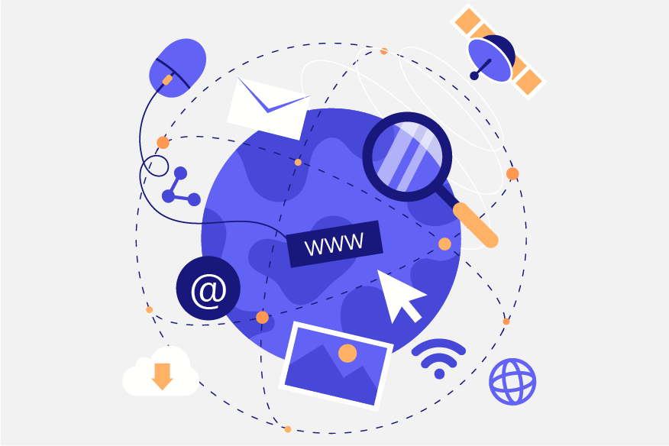
CLARIFICATION
World Wide Web (or the Web) is a term used to describe a network of the vast data system built on the Internet
World Wide Web plays a role as the Internet’s underlying client-server format

Slide 20
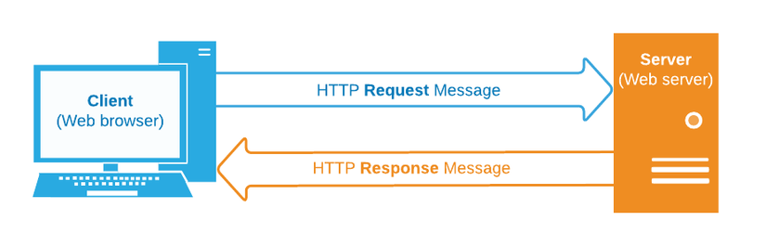
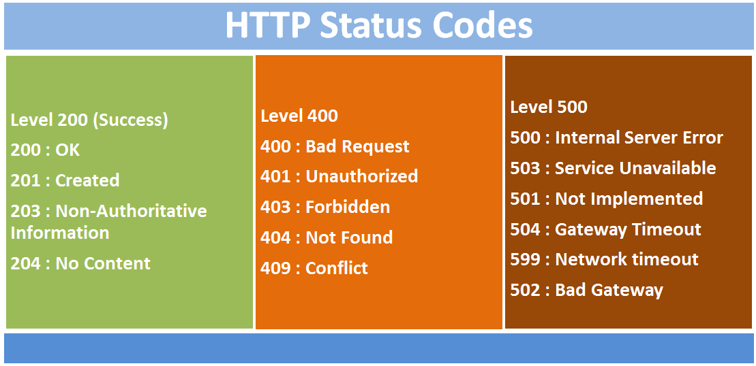
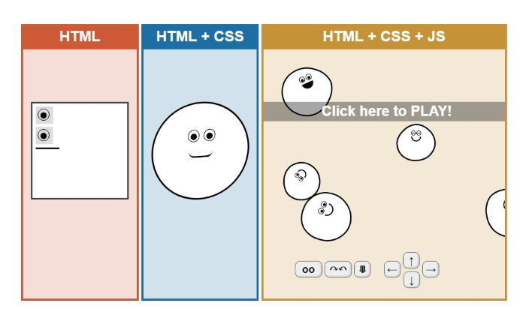
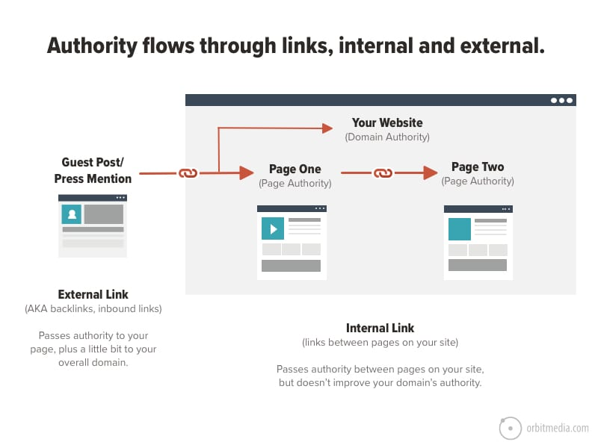

SEVERAL COMPONENTS
Domain Name
URL
HTTP
The combination of HTML, CSS and JAVASCRIPT
Linking
https://www.group20.com/FinalProject
Internet Protocol
Path
HTTP, which stands for HyperText Transfer Protocol, is the protocol used to transfer data over the World Wide Web and an application layer protocol.
URL or Uniform Resource Locator interpret a unique address that web resource can be found on the internet.
Linking is a defining concept of the Web, aiding its identity as a collection of connected documents.

Slide 21
Summary
01
02
03
04
Network Interface Layer
Providing communication services between hosts on the same network
Network Layer
IP handle and routing data packets between hosts on different networks
Transport Layer
Providing end-to-end communication services between applications running on different hosts
Application Layer
04
Providing communication services to end-users or applications

Slide 22
Thanks for your watching!

